Slide 1
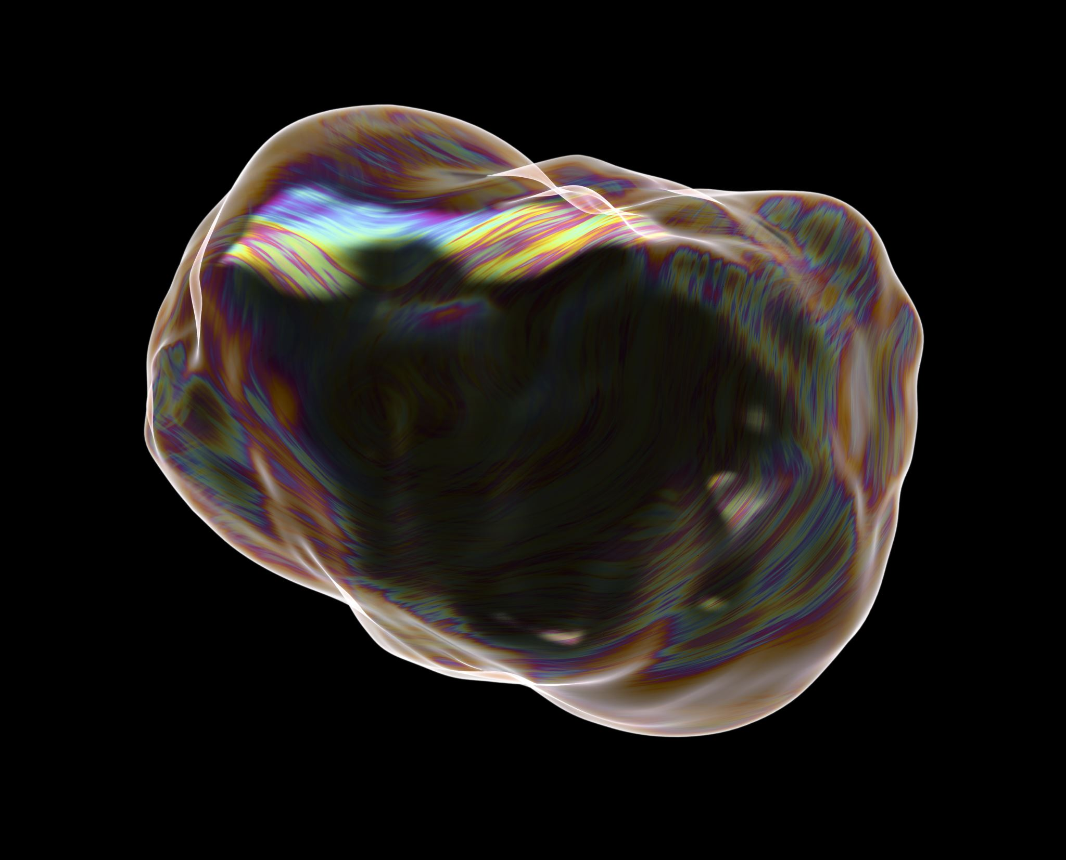
Data Collection And Curation Predicting Age of Abalone

Slide 2
PROJECT SUMMARY
Abalone is a gastropod mollusk which is a very popular, flavorful, nutritious and expensive sea food and also, its shell are used for decoration.
The age of abalone is determined by cutting the shell through the cone, staining it, and counting the number of rings through a microscope -- a boring and time-consuming task.
There are 8 input attributes (Sex, Length, Height, Diameter, Whole weight, Shucked weight, Viscera weight, Shell weight) and one output attribute, Ring
To predict the age 1.5 is added to the predicted Ring Value.
The dataset is taken from the following Link:- https://archive.ics.uci.edu/ml/datasets/abalone
There are around 4177 Rows in the dataset.
The project aims to predict the age of abalone from physical measurements.

Slide 3
Project Audiences
Farming: Abalone is a very expensive, flavorful, nutritious sea food and, its shells are used as decorative items. That’s why, commercial farming of abalone is increasingly successful.
Food Market: The meat of abalone is popular in certain parts of Latin America, France, New Zealand, East Asia, and Southeast Asia. There is a big consumer market of abalone worldwide and its of a big commercial value.
Ecologists: Abalone is threatened to extinction due to overfishing and this may affect the sea ecosystem.
Handicraft industry: The shells of abalone is used to make jewelry, buttons and as inlay in furniture and musical instruments.

Slide 4
Tools and Technologies Used
Google Colab: - Colaboratory, or “Colab” for short, is a product from Google Research. Colab allows anybody to write and execute arbitrary python code through the browser, and is especially well suited to machine learning, data analysis and education.
Python: - A high-level, interpreted, general-purpose programming language. Its design philosophy emphasises code readability with the use of significant indentation.
Pyspark: - Pyspark: Pyspark is a connection between Apache Spark and Python. It is a Spark Python API and helps you connect with Resilient Distributed Datasets (RDDs) to Apache Spark and Python.
MatplotLib: - Matplotlib is a low-level graph plotting library in python that serves as a visualization utility. Matplotlib is open source and can be used freely.

Slide 5
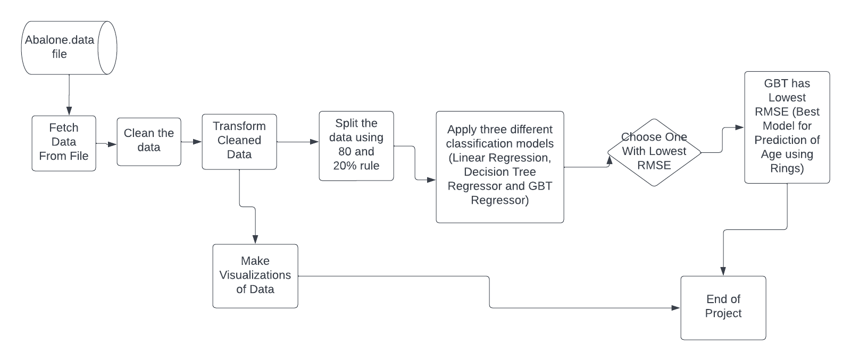
Flow Chart

Slide 6
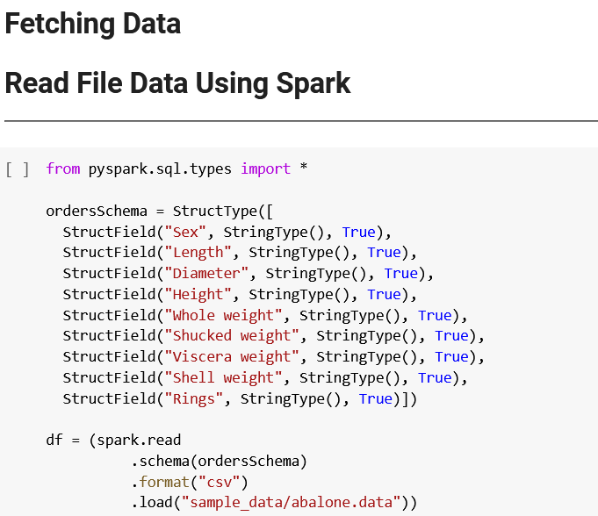
Source Code: Prediction

Slide 7
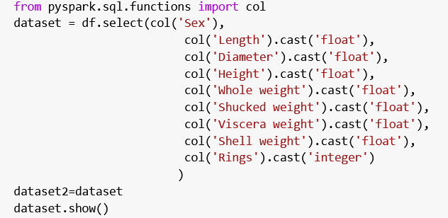
Data Cleaning and Transformation
Source Code: Prediction

Slide 8
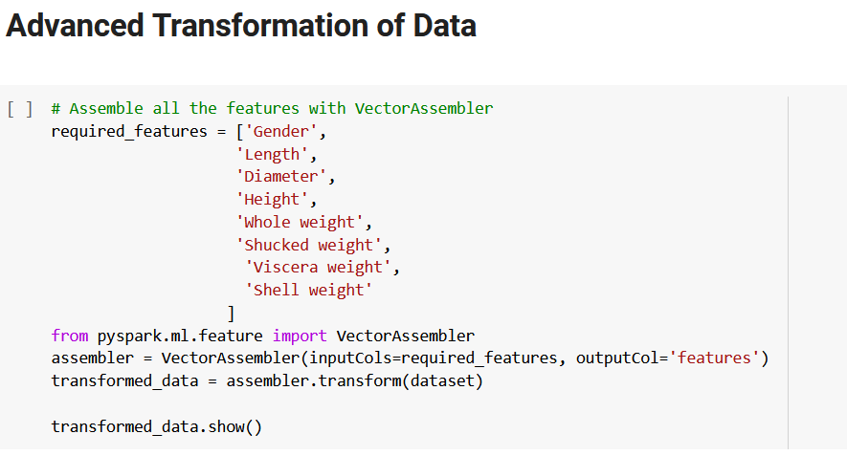
Source Code: Prediction

Slide 9
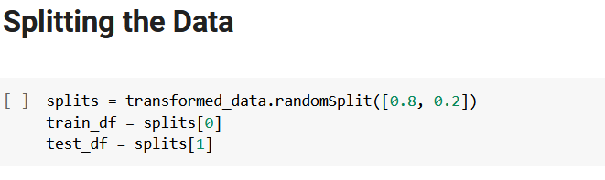
Source Code: Prediction

Slide 10
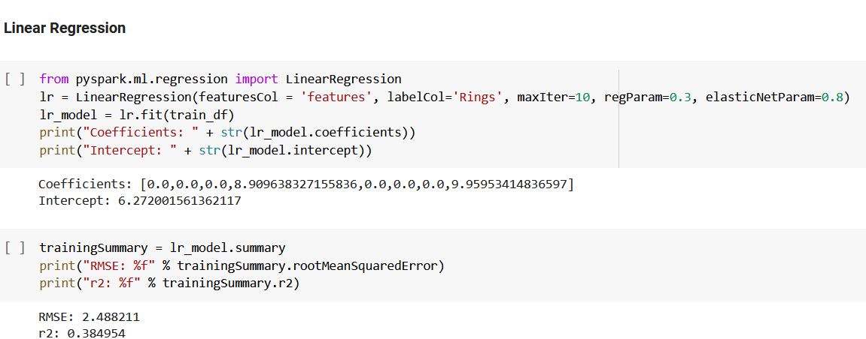
Source Code: Prediction

Slide 11
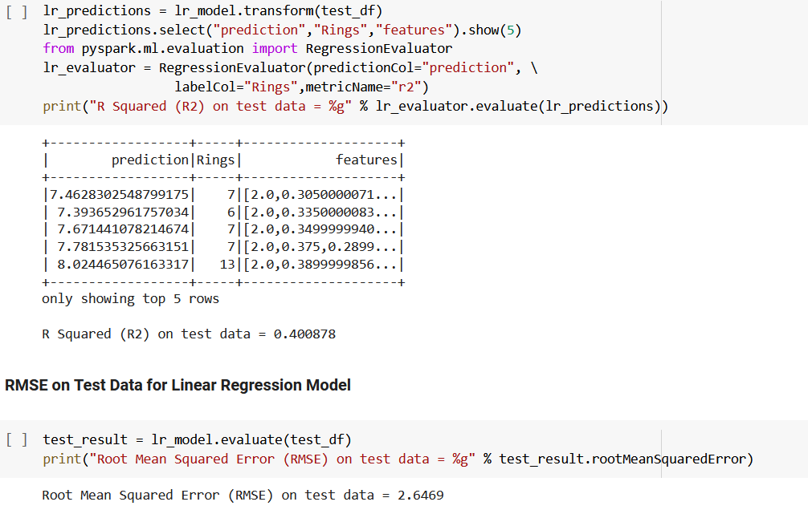
Source Code: Prediction

Slide 12
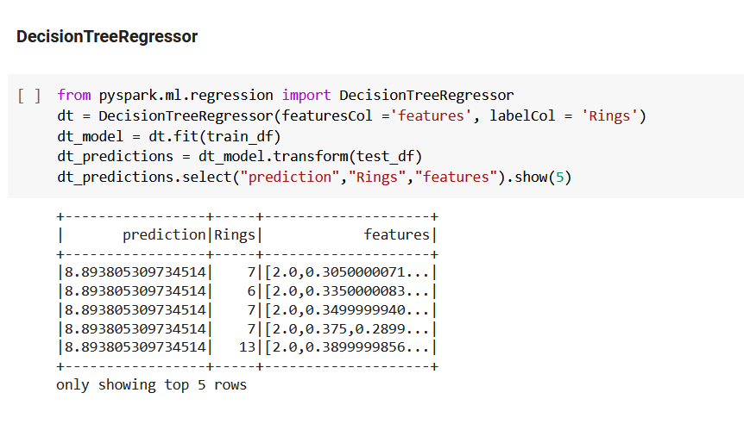
Source Code: Prediction

Slide 13
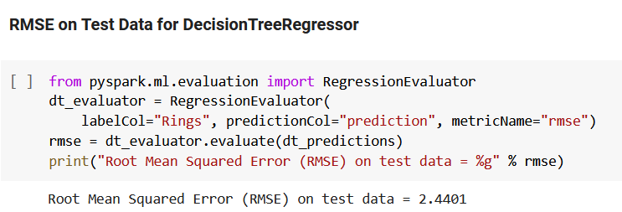
Source Code: Prediction

Slide 14
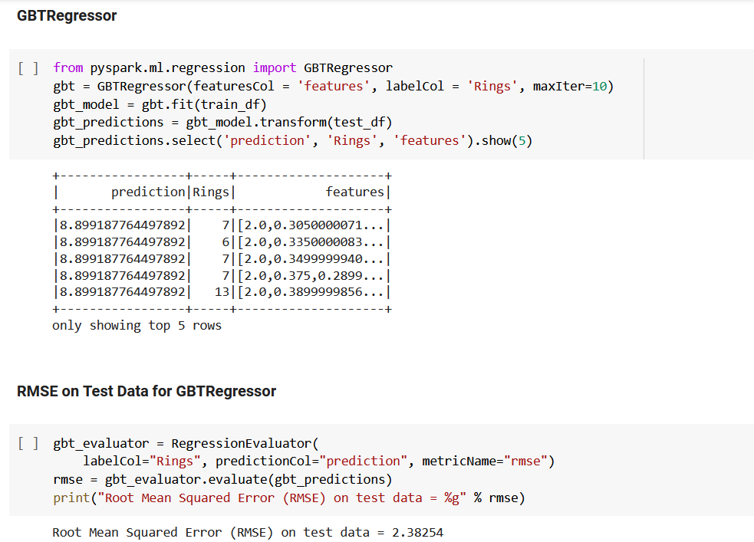
Source Code: Prediction

Slide 15
Result
The RMSE for GBT Regressor is the least so this model is best for this data prediction of abalone age

Slide 16
Business Questions
Q1 - The Proportion of Sex of Abalone
Q2 - Top Length of Female and Male Abalone
Q3 - Average Whole Weight of Abalone
Q4 - Comparison of Whole and Shucked Weight
Q5 - The Distribution of Rings of Abalone (Qty)

Slide 17
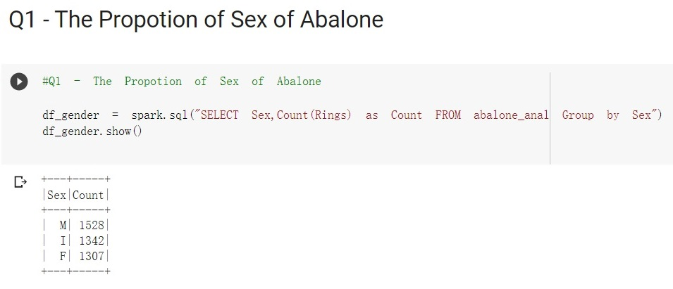
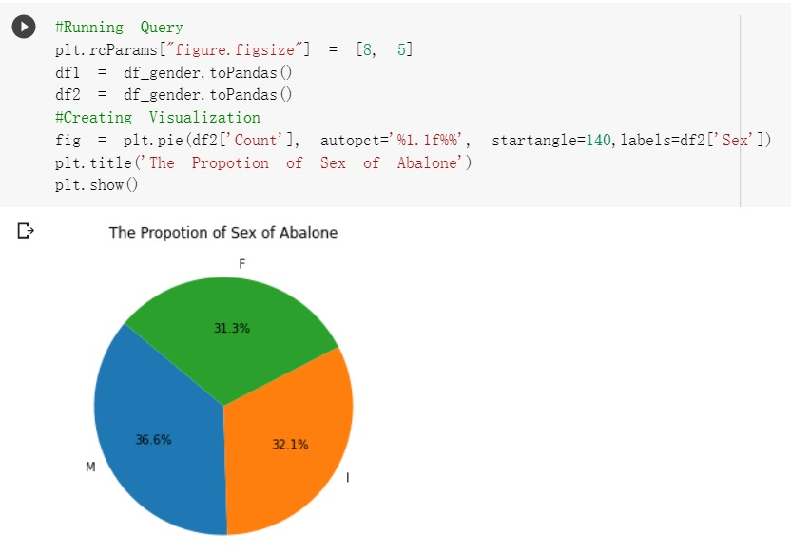

Slide 18
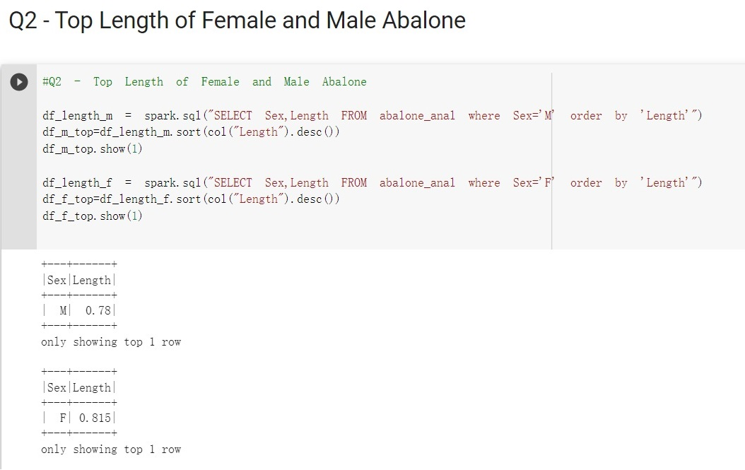

Slide 19
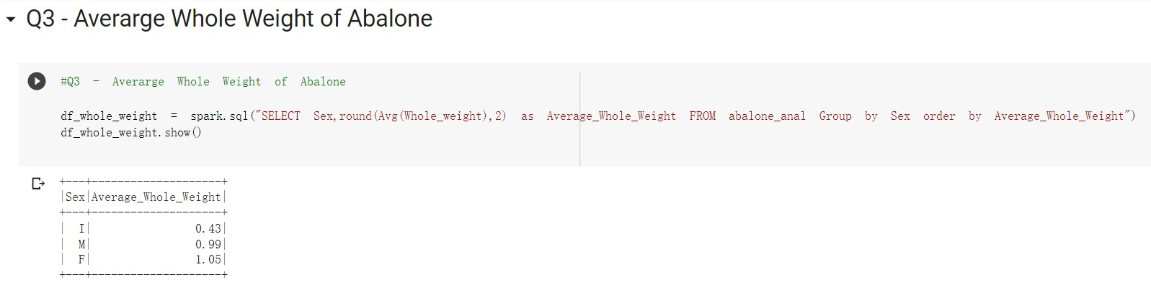
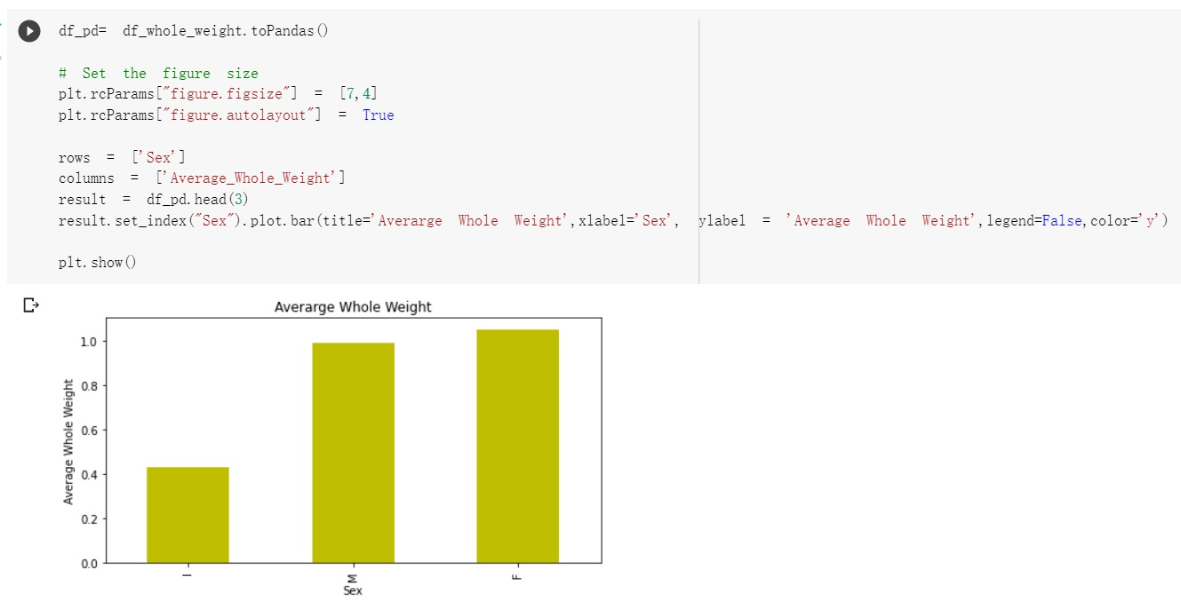

Slide 20
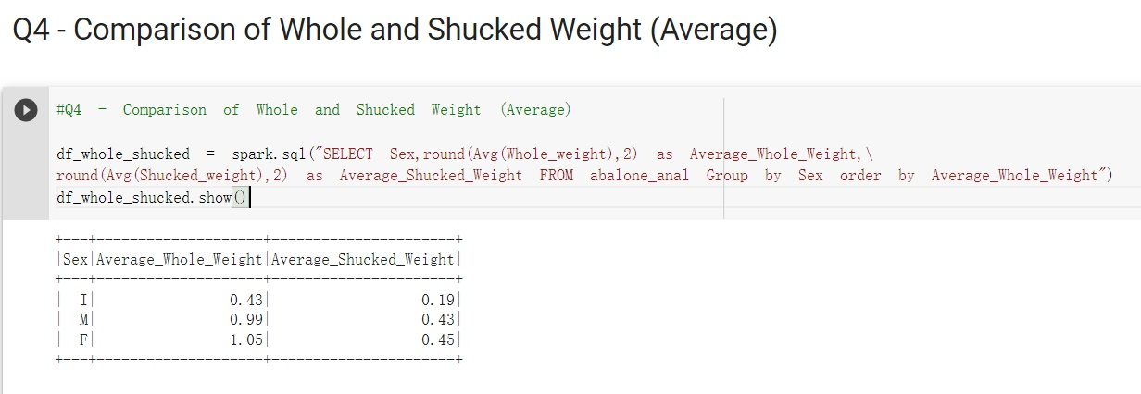
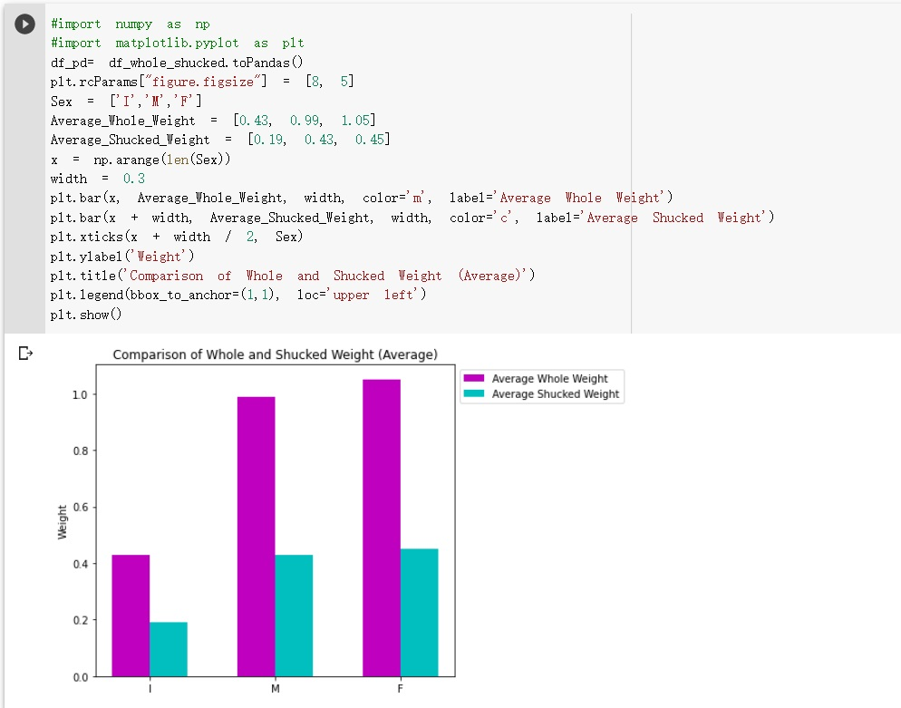

Slide 21
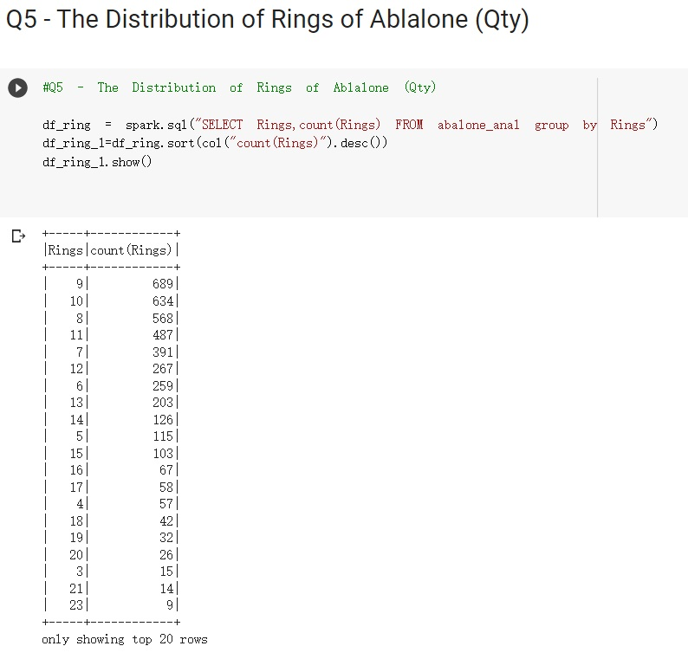
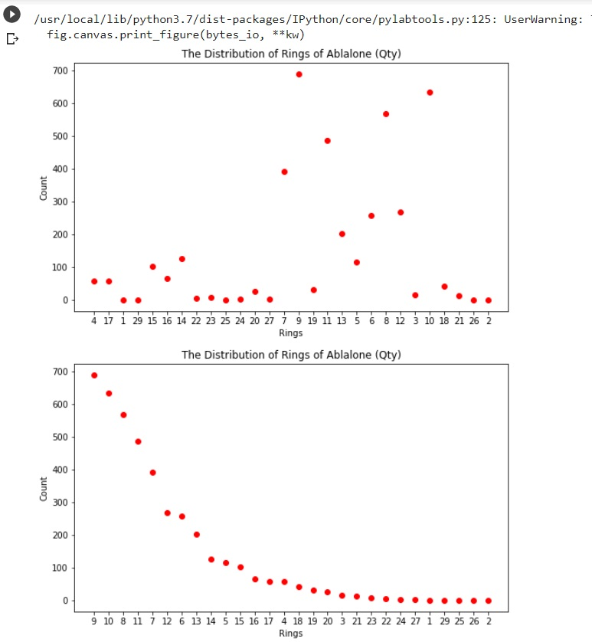
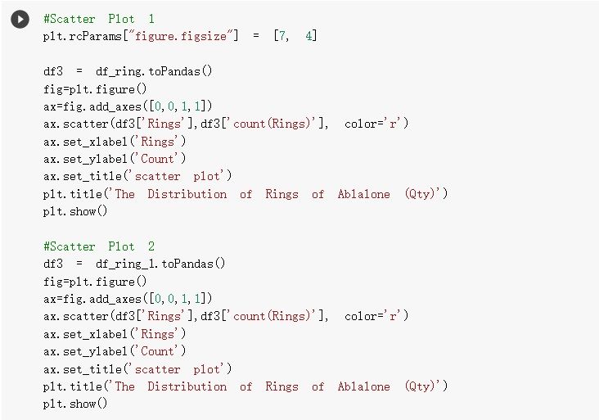

Slide 22
Insights Conclusion
The largest proportion is male at 36.6%, infants at 32.1%, and the last is female at 31.3%.
Female abalone has the longest size with 0.815, and the male is 0.78.
Female has the heaviest weight at 1.05, while the male is 0.99.
The overall shucked weight among each gender is less than half of the whole weight.
Most of the ring quantities are 8,9,10, with more than 500 on the dataset. Still, numerous rings are less than 100 quantities.

Slide 23
Thank You

